Slide 1
The American Legion Riders
The American Legion
Department of Texas
Fall Conference
Notes:
Welcome, everyone! Glad to be here for your Mid-Winter Conference, and always good to see the Texas Riders.
The next few hours of instruction are based on National Commander Jim Koutz’s emphasis on training and his new LEAD initiative—Leadership Education and Training. Each division of The American Legion was tasked with developing leadership training and to select instructors from national staff to travel and train at the request of the departments. The American Legion Riders Program office was no different.

Slide 2
The American Legion Riders
Notes:
The first part of the ALR training will last about 50 minutes, maybe a bit less. During the first 50 minutes we’ll cover the history of the Riders and some of the guiding resolutions and basic responsibilities of the chapters and membership. You should feel free to ask questions about the content as we go along, but I intend to give you a ten-minute break before beginning the second part of the training, which will go into a bit more detail about some of the program expectations and requirements, including the “5 Rules” of all American Legion programs.
(Point out locations of restrooms and smoking areas. Students should feel free to get up and leave if they must, but be quiet about it.) Show the LEAD pin and the requirements for students to receive the same.

Slide 3
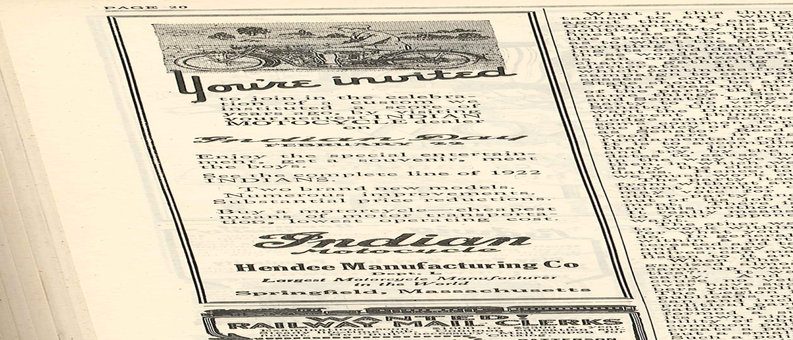
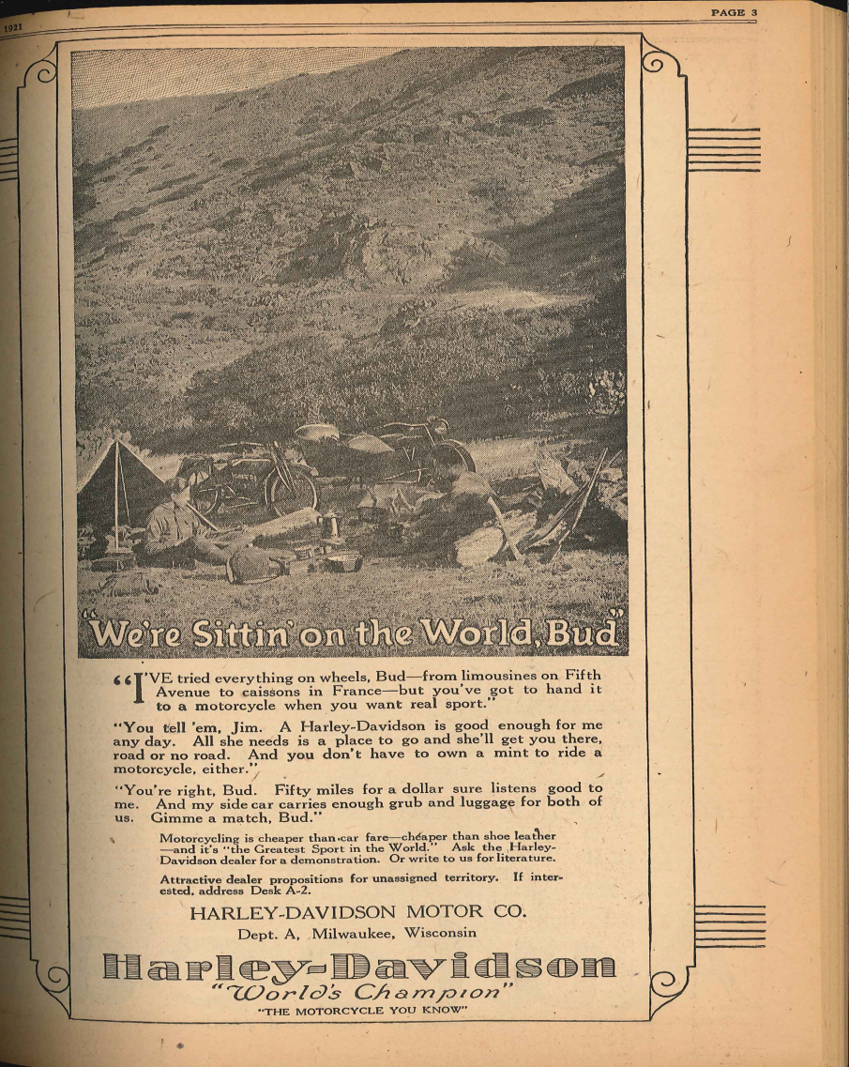
History
Legionnaires on motorcycles--?
Since our first days!
Advertising for Harley-Davidson® and Indian® motorcycles in The American Legion Magazine, 1921.
Notes:
Here describe the general history of motorcycling and The American Legion.
Advertisements were paid for by Harley Davidson, Henderson Motorcycles, Excelsior Motorcycles, and the Hendee Manufacturing Company (for Indian “Motocycles”) as early as 1920—the first year of existence of The American Legion.
After WWII, of course many of those men returning from overseas purchased the same machines that some of them rode in wartime—the Indians and the Harley-Davidsons and even the Cushman air-dropped paratroop motorcycles. With their leather jackets and with Marlon Brando along for the ride, they terrorized the countryside in films like “The Wild Ones.”
Those men and women of the WWII generation were outlaws. This is the reason the Riders suffer from such a bad reputation today!
In the 1950s – 1970s, many American Legion posts entered into friendly parade drill team competitions with Lions, Elks, Kiwanis and Shriners—many times in different divisions.

Slide 4
Post Expectations and Management
1. The American Legion Riders is a program of the Post.
2. The Post must address the Riders in their constitution and by-laws.

Slide 5
Resolution 5
Resolution 5 (May 2021)
Adopted the Riders is a national program to be administered by the posts and departments.
Declares each ALR must be supported by a post or department--and uphold the declared principals of the organization.
Provides recommended guidelines for operation.
Instructs Riders to abide by The American Legion constitution and bylaws and directives of department and post.
Provides for National and Department to maintain general oversight for proper use of name and emblem, compliance with national constitution and bylaws.
Notes:
Resolution 5 (Adopted by the NEC in May,2021)
Adopted the Riders is a national program to be administered by the posts and departments.
Declared each ALR must be supported by a post or department--and uphold the declared principals of the organization.
Provided recommended guidelines for operation.
Instructed Riders to abide by The American Legion constitution and bylaws and directives of department and post.
Provided for National and Department to maintain general oversight for proper use of name and emblem, compliance with national constitution and bylaws.

Slide 6
ALR Guidelines under Resolution 5
All members shall first be current AL/AUX/ SAL members in good standing.
All members shall own a licensed and insured motorcycle (amended October 2011).
All members shall maintain the image and reputation of The American Legion.
All members shall avoid images and practices of motorcycle “gangs” and “clubs.”
Notes:
All members shall first be current AL/AUX/ SAL members in good standing.
All members shall own a licensed and insured motorcycle (amended October 2011).
All members shall maintain the image and reputation of The American Legion.
All members shall avoid images and practices of motorcycle “gangs” and “clubs.”

Slide 7
ALR Guidelines under Resolution 5
The only authorized ALR marks/logos, if worn, are those owned by The American Legion.
All Riders will obey the motor vehicle laws of their state.
No use of rockers if such use is a violation of trademark.
The hosting department/post will review insurance and liability risks.
Notes:
The only authorized ALR marks/logos, if worn, are those owned or approved by The American Legion.
All Riders will obey the motor vehicle laws of their state.
No use of rockers if such use is a violation of trademark.
The hosting department/post will review insurance and liability risks.

Slide 8
Resolution 5
Resolution 5 was approved by the NEC in May 2021.
Resolution 5 allows current ALR members to remain full members if for medical or age reasons they could no longer ride.
This remains at the discretion of the local chapters, which may continue to maintain stricter standards.
Notes:
Resolution 32 was approved by the NEC in October 2011.
R32 amended R35 to allow current ALR members to remain full members if for medical or age reasons they could no longer ride. Important to know that this is left up to the local post and chapter! It remains at the discretion of the local chapters, which may continue to maintain stricter standards.

Slide 9
“Stricter Standards” Rule
Many posts may have stricter Rider SOPs.
  Post or chapter members might all belong to a certain profession or business group.
  A chapter (or department) may restrict minimum displacement to 650cc or make/model to BMWs.
Less strict standards than department or national SOPs or CB&Ls are not valid.
  Membership cannot be open to non-Legion Family.
  Less strict membership rules are never valid.
Notes:
“STRICTER STANDARDS” Rule:
Many posts may have stricter conditions for membership in their chapter. This is okay.
Post or chapter members might all belong to a certain profession or business group.
(It is allowable, for example, for a post to set up a Riders Chapter open ONLY to female riders)
A chapter (or department) may restrict minimum displacement to 650cc or make/model to BMWs.
But remember,
Less strict standards than department or national SOPs or CB&Ls are not valid.
Membership cannot be open to non-Legion Family.
Less strict membership rules are never valid.
Federal, state, and local laws and rules about ethnicity and equal opportunity may apply.

Slide 10
Accountability
ALL ALR chapters and groups must be affiliated with a hosting post or other recognized department body.
A CB&L is not required; a simpler SOP or other document is sufficient.
Riders are a program of the post—not a separate organization.
    Riders enjoy the same tax-exempt status as the hosting organization.
Notes:
ALL ALR chapters and groups must be affiliated with a hosting post or other recognized department body.
There is no such entity as a chapter that is not affiliated with an existing post.
It IS possible to have an all-ALR post.
If the post folds, the chapter is ended.
A CB&L is not required; a simpler SOP or other document is sufficient.
Riders are a program of the post—not a separate organization.
Riders enjoy the same tax-exempt status as the hosting organization.

Slide 11
Chapter Responsibilities
ALR officers are named by the hosting post.
  Chapters are normally given the courtesy of holding elections. Duly elected officers are then named or installed by the post.
  ALR officers may be removed/changed at any time by the post commander, general membership, and/or executive committee.
ALR organizational documents, and any changes, must be approved by the post.
Notes:
ALR officers are named by the hosting post. Elections are approved at next post meeting, and/or “installed” in an appropriate ceremony.
ALR officers may be removed/changed at any time by the post commander, general membership, and/or executive committee.
ALR organizational documents, and any changes, must be approved by the post.

Slide 12
Chapter Responsibilities
ALR Finances:
  ALR may have a bank account.
  A post officer (usually the post treasurer) must be signatory on such an account.
    Named on signature card at the bank.
    Does not mean this person has authority to approve or disapprove expenditures.
  Riders must render both a financial report and an activities report each month.
Notes:
ALR Finances:
ALR may have a bank account.
A post officer (usually the post treasurer) must be signatory on such an account.
Name on signature card at the bank.
Does not mean this person has authority to approve or disapprove expenditures.
Riders must render both a financial report and an activities report each month to the post.

Slide 13
ALR National Committee
Roy Helms
Chad Woodburn
Andrew Pajak
Jessie Horton
Ken Nadeau
Anthony Berenotto
Jim Day
Jon Hosfeld
The American Legion Riders National Liaison Committee to The Internal Affairs Commission.
Mark Clark, Chairman
Steve Ridenour, Vice-Chairman
Notes:
The American Legion Riders National Liaison Committee to The Internal Affairs Commission.

Slide 14
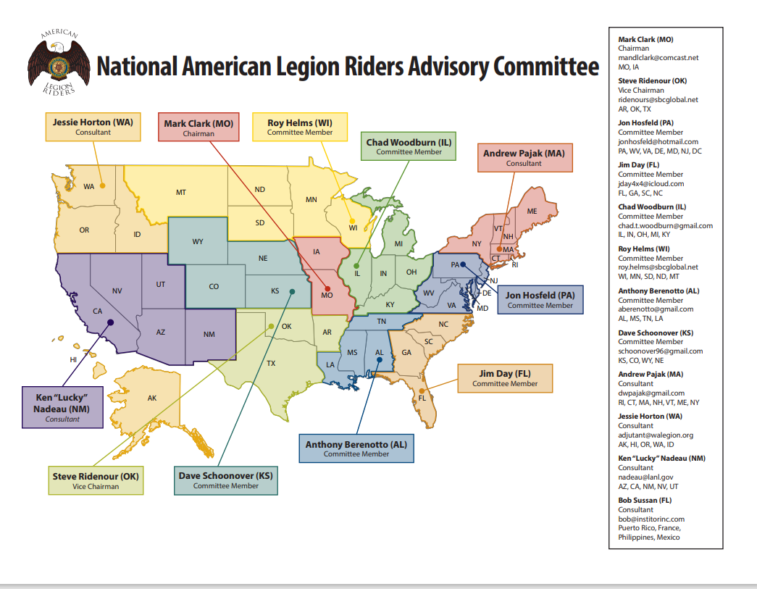

Slide 15
Best Practices
Discussion
Notes:
I can tell you now that from where I’m sitting, Indiana already has some of the best practices in the country for organization, structure, elections, travel, and participation and I use Indiana as an example a lot while I’m traveling.
(Solicit other good news about the department’s ALR program.)

Slide 16
The American Legion Riders®
Logo, patch, and words The American Legion Riders® are registered service marks of The American Legion®
“Legion Riders” is also considered by the courts to be protected from use by other groups to describe motorcycle programs.
Notes:
The American Legion Riders® (notice the registered mark sign on my title?)
Logo, patch, and words The American Legion Riders® are registered service marks of The American Legion®
“Legion Riders” is also considered by the courts to be protected from use by other groups to describe motorcycle programs.

Slide 17
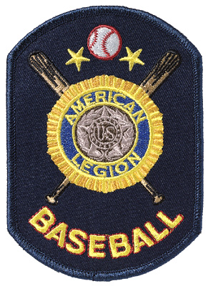
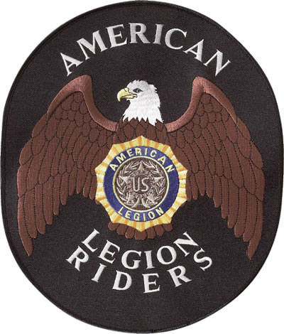
Patches
Notes:
ALR Patch and Baseball Patch…full color images. Compare to the next slide:

Slide 18

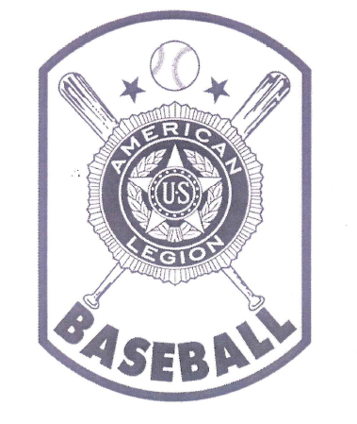
Patch Borders
Notice the border on the American Legion Baseball® emblem…since removed.
Notes:
These are the images of the trademarks on file with the United States Trademark Office (Patent Office, etc.)
The American Legion has some 40 different protected “marks” and we are very experienced at aggressively protecting them.

Slide 19
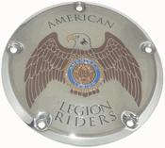
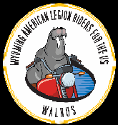
Permission
Permission to use the emblems or word marks will be granted by the National Adjutant for any legitimate purpose.
Clothing
Jewelry
Specialty items (derby covers)
Key chains
Wallets
Fundraising items
Notes:
Permission to use the emblems or word marks will be granted by the National Adjutant for any legitimate purpose.
Clothing
Jewelry
Specialty items (derby covers)
Key chains
Wallets
Fundraising items
Notice the two images? These have been granted permission by Flag and Emblem Sales to reproduce our marks. In the case of the Wyoming American Legion Riders for the US, or “WALRUS,” the permission was granted to use the words “American Legion Riders.”
The other is a derby cover for motorcycles. The vendor is an authorized vendor granted authority by Emblem Sales.

Slide 20
Penalties
Congress gives The American Legion “sole and exclusive right…” Title 36, Sect. 48, United States Code
“Whoever manufactures, sells, or purchases for resell…any article of merchandise bearing the…emblem…of a veteran’s organization…shall be fined…or imprisoned not more than 6 months, or both. Title 18, Sect. 705 U.S.C.
Notes:
Penalties
Congress gives The American Legion “sole and exclusive right…” Title 36, Sect. 48, United States Code.
“Whoever manufactures, sells, or purchases for resell…any article of merchandise bearing the…emblem…of a veteran’s organization…shall be fined…or imprisoned not more than 6 months, or both. Title 18, Sect. 705 U.S.C.

Slide 21





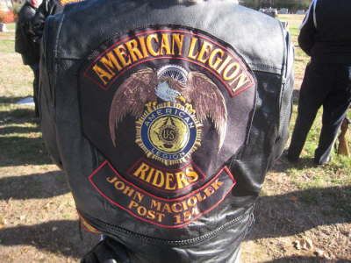

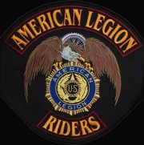
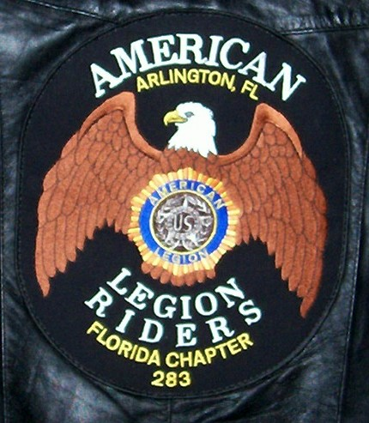

Improper Logos
Notes:
ALL of these patches are improper and in violation of our trademark, or generally do not meet the federal trademark protection rules.
(Explain distorted images, CT patch, ALR in background, multicolored background, pins on wings, CT patch again, Florida pirate patch (pretty good except for city name INSIDE trademarked area) and the latest Michigan attempt to sell shirts.
(Indiana is very good at getting permission for various uses. Compliment Post 500, Brownsburg, Lebanon and others)
Explain that permission is easy to get. Emblem will give your vendor a “license for a specific number of a specific design.”

Slide 22
Improper Logos

Slide 23
Improper Logos
Notes:
What happens to a post that allows a chapter to step outside federal trademark restrictions? We sue.
(We have no choice. Explain.)

Slide 24
Other Penalties
Federal courts have established corrective actions for instances of theft of marks. Members of an unincorporated group, or their heirs, may be sued individually for:
Court costs
Attorney fees
Damages
Personal property
Recovery of all items
Other legal remedies as court may direct
Notes:
The American Legion has a legal firm that takes the cases for us. All we provide them is a post name, address, and telephone number and a bit of evidence (image from post or chapter website or Facebook page will do)
Violation may be as simple as putting up a distorted image of the ALR patch, or even selling a post or chapter t-shirt without permission to use the Legion mark.
The American Legion has already taken several Riders chapters and posts to court. It has cost them dearly:
Court costs paid by the post/chapter (set by the court)
Attorney fees paid by the post/chapter (such fees are set by the legal firm specializing in federal trademark law).
Damages (Post or chapter must additionally pay triple the gross income from selling the merchandise (“treble damages”)
Recovery of all items (inventory remaining belongs to the Legion. Post ships to us at their expense.
Other legal remedies as court may direct. If post is not incorporated, and many are not, then each member of the post listed on the post roster, as well as the chapter, can be held individually liable for these damages, court costs, and attorney fees.
This is a serious matter!

Slide 25
Permission
Emblem Request form is in the Officers Guide, pages 153-154.
(or)
http://www.legion.org/emblem/request
Clothing
Jewelry
Specialty items (derby covers, rifles, or custom art)
Key chains
Wallets
Fundraising items
Permission is considered to be granted for routine post and department stationery, posters, or other daily needs—but should be obtained for any outside vendors preparing such letterhead, stationery, posters, and other goods—if they are good businesspersons they will know the risk.
Notes:
How to protect yourself?
Permission is considered to be granted for routine post and department stationery, posters, or other daily needs—but should be obtained for any outside vendors preparing such letterhead, stationery, posters, and other goods—if they are good businesspersons they will know the risk.
Stress that permission is granted in nearly all cases and is EASY to obtain. But do NOT exceed the number of items granted by Emblem—just ask again for 300 more t-shirts.

Slide 26
US Trademark Law
American Legion programs must satisfy the “constant and continuous control requirement” of US Trademark Law.
  True whether or not a charter exists.
  True whether or not the program forms a 501c entity of any sort.
ALR programs must follow the five rules of subsidiary corporations.
  This is true of all American Legion programs with trademarked logos or words. Ex: AL Baseball, Oratorical, Sons of The American Legion, Legacy Scholarship, NEF, etc.
Notes:
American Legion programs must satisfy the “constant and continuous control requirement” of US Trademark Law.
True whether or not a charter exists.
True whether or not the program forms a 501c entity of any sort.
ALR programs must follow the five rules of subsidiary corporations.
This is true of all American Legion programs with trademarked logos or words. Ex: AL Baseball, Oratorical, Sons of The American Legion, Legacy Scholarship, NEF, etc.

Slide 27
ALR Constitutions and Bylaws
Constitutions and Bylaws?
  Nice, but not necessary– this is a NALRIC artifact.
  Introduces difficulty in changing program.
  Widespread use of C&BL does not mean it is necessarily the most efficient way to run a program.
Other forms of organizational documents
    SOPs (easier to change with member input)
    Articles of Incorporation
    “House rules”
Notes:
Constitutions and Bylaws?
Nice, but not necessary– this is a NALRIC artifact.
Introduces difficulty in changing program.
Widespread use of C&BL does not mean it is necessarily the most efficient way to run a program.
Other forms of organizational documents
SOPs (easier to change with member input)
Articles of Incorporation
“House rules”

Slide 28

Legal Issues
Should we form a separate nonprofit? Should we split into a charitable" organization?
501(c)19?...or 501(c)3?
…a complicated and dangerous area!
Notes:
Should we form a separate nonprofit? Should we split into a charitable" organization?
501(c)19?...or 501(c)3?
…a complicated and dangerous area. Be careful that you don’t shoot your own foot off and become too much of a separate legal entity and lose your right to wear the Legion logos and tradmarks.

Slide 29
Nonprofit “legal entities”
501c(19) - organizations or posts of past military veterans
501c(3) - charitable organizations
Auxiliaries and subordinate programs of posts are already tax-exempt.
Logos and naming permissions already granted as a program of The American Legion.
As separate legal entities:
  Lose the right to wear the American Legion names/logos.
  Must file forms 990 and other documents.
  Are still subject to “5 Rules.”
  Cannot lobby for veterans.
  Status does not protect post.
  May be sued.
Notes:
Auxiliaries and subordinate programs of posts are already tax-exempt.
Logos and naming permissions already granted as a program of The American Legion.
But—as 501c3 organizations, (as separate legal entities):
Lose the right to wear the American Legion names/logos.
Must file forms 990 and other documents.
Are still subject to “5 Rules” so nothing is gained.
Cannot lobby for veterans.
Status does not protect post.
Your entity still may be sued.

Slide 30
Finances and Insurance
Resolution 5:
“Sponsoring organization (Post and Department) will review liability insurance coverage to ensure that adequate coverage is available to cover the organization to include coverage for any specific special riding events; . . .”
Notes:
Resolution 5:
“Sponsoring organization (Post and Department) will review liability insurance coverage to ensure that adequate coverage is available to cover the organization to include coverage for any specific special riding events; . . .”
This means the post and department are only required to cover themselves…ALR members and chapters should take proper steps to procure adequate individual and chapter coverage as needed under state law and common sense.

Slide 31

The American Legion Riders
Questions?
Notes:
Questions?

Slide 32
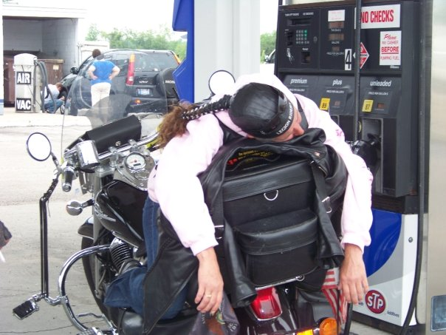
Notes:
Thank you!

